Slide 1
PULse width modulation
By Tahseen Asma Meem

Slide 2
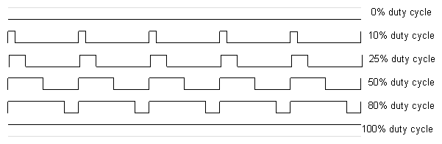
PWM
Pulse Width Modulation, or PWM, is a technique for getting analog results with digital means. Digital control is used to create a square wave, a signal switched between on and off. This on-off pattern can simulate voltages in between the full VCC of the board (e.g., 5 V on UNO) and off (0 Volts). The duration of "on time" is called the pulse width. To get varying analog values, the pulse width can be varied. If this on-off pattern is repeated fast enough with an LED, for example, the result is as if the signal is a steady voltage between 0 and Vcc controlling the brightness of the LED.

Slide 3
PWM
The Arduino's programming language makes PWM easy to use; simply call analogWrite(pin, dutyCycle), where dutyCycle is a value from 0 to 255, and pin is one of the PWM pins (3, 5, 6, 9, 10, or 11). The analogWrite() function provides a simple interface to the hardware PWM, but doesn't provide any control over frequency.
The main PWM modes are "Fast PWM" and "Phase-correct PWM"

Slide 4
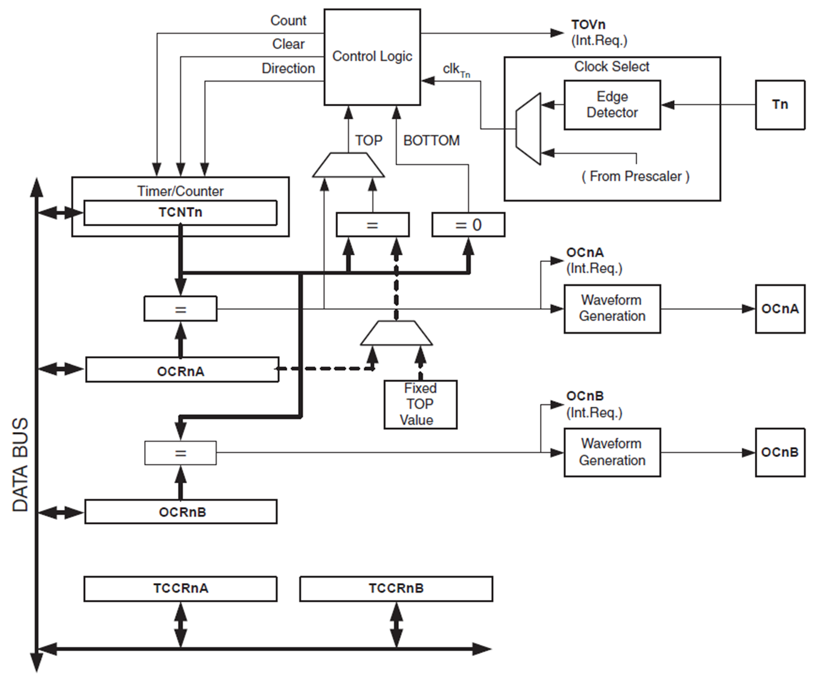
Fast PWM Mode
The fast Pulse Width Modulation or fast PWM mode (WGM02:0 = 3 or 7) provides a high-frequency PWM waveform generation option. The fast PWM differs from the other PWM option in its single-slope operation.
The counter counts from BOTTOM to TOP and then restarts from BOTTOM.
In noninverting Compare Output mode, the Output Compare (OC0x) is cleared on the compare match between TCNT0 and OCR0x, and set at BOTTOM.
In inverting Compare Output mode, the output is set on compare match and cleared at BOTTOM.

Slide 5
Fast PWM Mode
Due to the single-slope operation, the operating frequency of the fast PWM mode can be twice as high as the phase correct PWM mode that uses dual-slope operation.
This high frequency makes the fast PWM mode well suited for power regulation, rectification, and DAC applications.
High frequency allows physically small-sized external components (coils, capacitors), and therefore reduces total system cost.

Slide 6
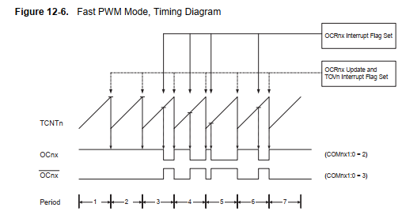
Fast PWM Mode
In fast PWM mode, the counter is incremented until the counter value matches the TOP value. The counter is then cleared at the following timer clock cycle.
The timing diagram for the fast PWM mode is shown in Figure 12-6.
The TCNT0 value is in the timing diagram shown as a histogram for illustrating the single-slope operation.
The diagram includes non-inverted and inverted PWM outputs.
The small horizontal line marks on the TCNT0 slopes represent compare matches between OCR0x and TCNT0.

Slide 7
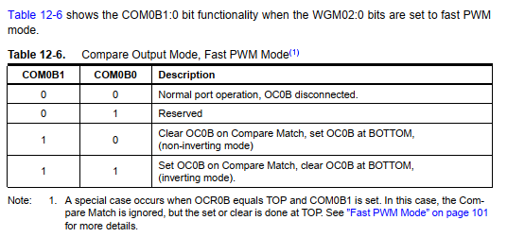


Fast PWM Mode
In fast PWM mode, the compare unit allows the generation of PWM waveforms on the OC0x pins. Setting the COM0x1:0 bits to 10 will produce a non-inverted PWM and an inverted PWM output can be generated by setting the COM0x1:0 to 11: Setting the COM0A1:0 bits to 01 allows the OC0A pin to toggle on Compare Matches if the WGM02 bit is set. This option is not available for the OC0B pin (see Table 12-6 ).

Slide 8

Fast PWM Mode
The actual OC0x value will only be visible on the port pin if the data direction for the port pin is set as output.
The PWM waveform is generated by setting (or clearing) the OC0x Register at the compare match between OCR0x and TCNT0, and clearing (or setting) the OC0x Register at the timer clock cycle the counter is cleared (changes from TOP to BOTTOM).
The PWM frequency for the output can be calculated by the following equation:
The N variable represents the pre-scale factor (1, 8, 64, 256, or 1024).
The waveform generated will have a maximum frequency of fOC0 = fclk_I/O/2 when OCR0A is set to zero.

Slide 9
Phase correct PWM Mode
The phase correct PWM mode (WGM02:0 = 1 or 5) provides a high-resolution phase correct PWM waveform generation option. The phase correct PWM mode is based on a dual-slope operation. The counter counts repeatedly from BOTTOM to TOP and then from TOP to BOTTOM.
In noninverting Compare Output mode, the Output Compare (OC0x) is cleared on the compare match between TCNT0 and OCR0x while up counting, and set on the compare match while down counting.
In inverting Output Compare mode, the operation is inverted.
The dual-slope operation has a lower maximum operation frequency than the single-slope operation.
However, due to the symmetric feature of the dual-slope PWM modes, these modes are preferred for motor control applications.

Slide 10
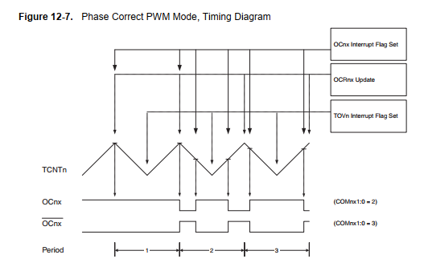
Phase correct PWM Mode
In phase correct PWM mode the counter is incremented until the counter value matches TOP. When the counter reaches TOP, it changes the count direction.
The TCNT0 value will be equal to TOP for one timer clock cycle. The timing diagram for the phase correct PWM mode is shown on Figure 12-7.
The TCNT0 value is in the timing diagram shown as a histogram for illustrating the dual-slope operation.
The diagram includes non-inverted and inverted PWM outputs. The small horizontal line marks on the TCNT0 slopes represent compare matches between OCR0x and TCNT0.

Slide 11
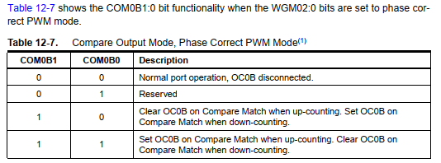
Phase correct PWM Mode
The Timer/Counter Overflow Flag (TOV0) is set each time the counter reaches BOTTOM.
The Interrupt Flag can be used to generate an interrupt each time the counter reaches the BOTTOM value.
In phase correct PWM mode, the compare unit allows the generation of PWM waveforms on the OC0x pins. Setting the COM0x1:0 bits to 10 will produce a non-inverted PWM.
An inverted PWM output can be generated by setting the COM0x1:0 to 11: Setting the COM0A0 bits to 01 allows the OC0A pin to toggle on Compare Matches if the WGM02 bit is set. This option is not available for the OC0B pin (see Table 12-7 on page 108).

Slide 12

Phase correct PWM Mode
The PWM waveform is generated by clearing (or setting) the OC0x Register at the compare match between OCR0x and TCNT0 when the counter increments, and setting (or clearing) the OC0x Register at compare match between OCR0x and TCNT0 when the counter decrements.
The PWM frequency for the output when using phase correct PWM can be calculated by the following equation:
The N variable represents the prescale factor (1, 8, 64, 256, or 1024).
The waveform generated will have a maximum frequency of fOC0 = fclk_I/O.
The extreme values for the OCR0A Register represent special cases when generating a PWM waveform output in the phase correct PWM mode.
If the OCR0A is set equal to BOTTOM, the output will be continuously low and if set equal to MAX the output will be continuously high for non-inverted PWM mode.
For inverted PWM the output will have the opposite logic values.

Slide 13
Example to Self practice:
Calculate the PWM frequency for the output when using fast PWM mode and phase correct PWM when fOC0 is 10MHz and the pre-scale factors are 1, 8, 64, 256, or 1024. Comment on the results afterward.

